Slide 1

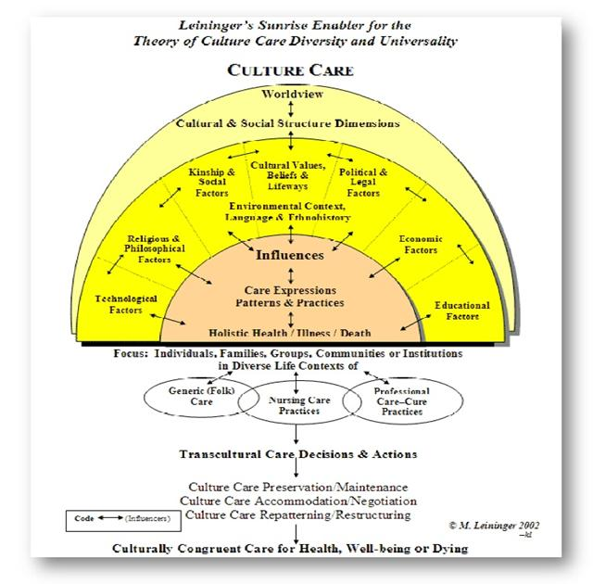
Nurse Education of Pain Management and Race
Phillips School of Nursing
at Mount Sinai Beth Israel
Introduction
Significance: Education Confront Biases and Allows Cultural Competency In Pain Management
Proposal/Project
The goal of pain management to ease or fully get rid of the pain that a patient may feel. While it may seem that this treatment of a patients pain by healthcare providers may be equal, it is not. Discrepancies can occur, but are not limited due to a patients
Religion
Socioeconomic class
Race/ethnicity
Gender
In the case of this project, the discrepancies between pain management and race are being specifically examined.
Minorities are more likely to downplay the pain they feel due to the cultural significance of how those groups were raised handle pain. Even if the healthcare personal are assessing these patients for hold no misconceptions regarding of one racial/ethnic group handling pain better that the other, they still might not grasp the extent of the pain felt by that patient. Biases of thinking that one group, can handle pain better is another issue that leads to the discrepancy in pain management.
As a result, minorities are more likely to not be prescribed opioids in the hospital and as prescriptions after discharge and may also wait a longer time in the ED waiting to be seen for their pain compared to the majority group.
In approaching strategies to fix this issue, it is unlikely that entire cultures will change to make people more willing convey their pain to the fullest degree if they are taught to undermine it. It is possible, however that through education of the healthcare personal, preconceived notions as to what a patients may or may nor handle pain based on race can be confronted. Through that confrontation, that there is a greater chance to lessen the gap between the discrepancies between pain management and race.
To have a workshop where research literature and exercises where students examine their own notions of pain and race.
This workshop would allow students to become more aware on the perception of race, especially in regards to how one views it and how it it culturally handled. The research design is experimental.
The proposal to the school to add the teaching workshop is to demonstrate that pain management is not being treated based off of evidence based practice as the standard that is should be, but rather through preconceived notions and the lack of cultural awareness. In the implantation of this workshop, where students are to be made aware of these issues, and in taking that awareness with them in practice, disparities can be lessened and patient satisfaction can increase.
The the subject would be an ABSN class of students room of a nursing school class in a metropolitan city like New York, ABSN students were chosen instead of the traditional BSN students due to the fast pace of the program, thus having a faster clinical exposure in a shorter period of time. A metropolitan city was chosen due a greater patient diversity thus allowing for a better equally represented patient style.
Before the start of clinical practice, half of the class would be required to attend the workshop as the experimental group and the other half of the class would not acting as the control group. In the span of one year of clinical practice, surveys would be administered to the patients of the students consisting of a 5 point Likert scale asking the following questions:
1. “How would you rate your previous pain level? “
2. “How would you rate your pain level now?
3 “How comfortable were you stating your previous pain level to the nursing student?”
4. “ Did you feel that the nursing student was receptive to listening to you?
5. “How well do you think the student handled your pain management?”.
Research Problem
Minorities are less likely to be given adequate pain management. This discrepancy may have occurred due to two main possibilities.
Minorities (African Americans/Blacks, Hispanics, Asians, Native Americans, etc.) were more likely to tended to downplay the pain they feel and live as normally as possible due to how they were raised, while Caucasians/Whites tended to be more aggressive in their pain treatment (Im and Chee 2011).
Biases on what different races can handle, regarding pain (Hollingshead, Meints, Miller, Robinson, & Hirsh, 2016).
PICO QUESTION
Conceptual Framework
Would a specialized workshop on the connections between race and pain management disparities in a pre-clinical setting of ABSN nursing students result in less disparities in the treatment of pain as opposed to students not taking the workshop, within one year of student clinical practice?
Leininger’s Culture Care Thoery can be applied to this project. The theory takes into consideration the culture of the patients and that they vary and can impact the care of the patients. By recognizing and incorporating a patient's cultural values and traditions into the line of care for patient, they can be treated more efficiently.
Limitations and Conclusion
While testing in a metropolitan area allows for a more diverse patient setting, it would be beneficial to test the effect of the workshop in a more rural/suburban settings also, where diversity among patients are not seen and as a result some biases may be greater.
The likely hood that patients may not be compliant and not full out the survey which is the main determining factor in seeing if the workshop was beneficial
References
Cavalier Jr, J., Hampton, S. B., Langford, R., Symes, L., & Young, A. (2018). The Influence of Race and Gender on Nursing Care Decisions: A Pain Management Intervention. PainManagement Nursing, 19(3), 238–245.
Disparities. (n.d.). Retrieved July 6, 2019, from https://www.healthypeople.gov/2020/about/foundation-health-measures/Disparities
Epps, C. D., Ware, L. J., & Packard, A. (2008). Ethnic Wait Time Differences in Analgesic Administration in the Emergency Department. Pain Management Nursing, 9(1), 26–32.https://doi.org/10.1016/j.pmn.2007.07.005
Heins, J. K., Heins, A., Grammas, M., Costello, M., Huang, K., & Mishra, S. (2006). Disparities in analgesia and opioid prescribing practices for patients with musculoskeletal pain in theemergency department. Journal of Emergency Nursing, 32(3), 219–224.
Hoffman, K. M., Trawalter, S., Axt, J. R., & Oliver, M. N. (2016). Racial bias in pain assessment and treatment recommendations, and false beliefs about biological differences between blacks and whites. Proceedings of the National Academy of Sciences of the United States of America, 113(16), 4296–4301. https://doi.org/10.1073/pnas.1516047113
Hollingshead, N. A., Meints, S. M., Miller, M. M., Robinson, M. E., & Hirsh, A. T. (2016). A comparison of race-related pain stereotypes held by White and Black individuals. Journal of Applied Social Psychology, 46(12), 718–723.
Im, E.-O., & Chee, W. (2011). The DSCP-CA: A Decision Support Computer Program-Cancer Pain Management. CIN: Computers, Informatics, Nursing, 29(5), 289–296.
Mack, D. S., Hunnicutt, J. N., Jesdale, B. M., & Lapane, K. L. (2018). Non-Hispanic Black-White disparities in pain and pain management among newly admitted nursing home residents with cancer. Journal of Pain Research; Macclesfield, 11, 753–761.http://dx.doi.org.eresources.mssm.edu/10.2147/JPR.S158128
Paulson, M., & Dekker, A. H. (2005). Healthcare disparities in pain management. The Journal of the American Osteopathic Association, 105(6_suppl_3), S14–S17.
Vallerand, A. H., Hasenau, S., Templin, T., & Collins-Bohler, D. (2005). Disparities between black and white patients with cancer pain: The effect of perception of control over pain.Pain Medicine, 6(3), 242–250.
Wandner, L. D., Heft, M. W., Lok, B. C., Hirsh, A. T., George, S. Z., Horgas, A. L., … Robinson, M. E. (2014). The impact of patients’ gender, race, and age on health careprofessionals’ pain management decisions: An online survey using virtual human
technology. International Journal of Nursing Studies, 51(5), 726–733.
Wheeler, E., Hardie, T., Klemm, P., Akanji, I., Schonewolf, E., Scott, J., & Sterling, B. (2010). Level of pain and waiting time in the emergency department. Pain Management Nursing,11(2), 108–114.
Wyatt, R. (2013, May 01). Pain and Ethnicity. Retrieved July 9, 2019, from https://journalofethics.ama-assn.org/article/pain-and-ethnicity/2013-05
Figure 1. Leininger’s Culture Care Thoery Sunrise Model

